Slide 1
If the moon had the mass of a golf ball, the sun would have the mass of about 110 school buses!
Although the moon is much smaller than the sun is, the moon exerts more influence on Earth’s tides than the sun does. Why do you think this happens?
A

Slide 2
Tides
The daily changes in the level of ocean water are called tides. Tides are influenced by the sun and the moon and occur at predictable times.
High Tide and Low Tide How often tides occur and the difference in tidal levels depend on the position of the moon as it revolves around the Earth.

Slide 3
The Moon has the greatest impact on the tides
Battle of the Bulge When part of the ocean is directly facing the moon, the water there and the water on the opposite side of Earth bulges toward the moon. The bulges are called high tides
Water is drawn away from the areas between the high tides, which causes low tides to form.

Slide 4
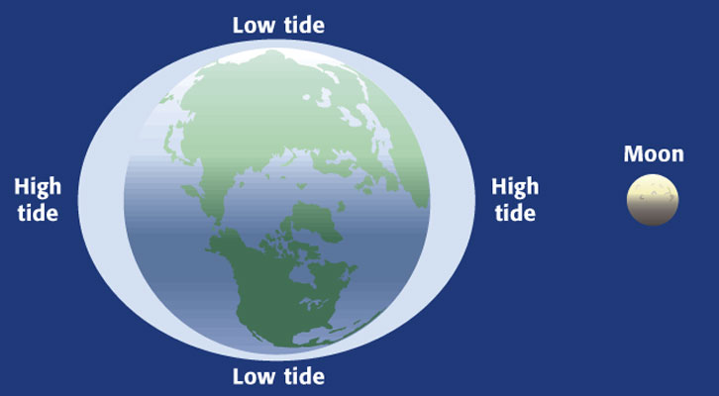
The “bulge” follows the moon

Slide 5
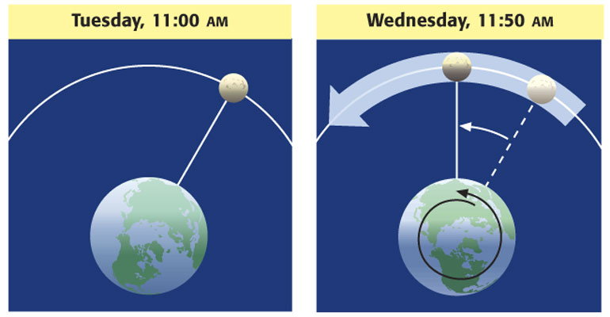
Timing the Tides: Tides occur at different times each day because the Earth rotates more quickly than the moon revolves around the Earth.

Slide 6
The sun also tugs on the water
The sun also affects tides. The combined forces of the sun and the moon on Earth result in tidal ranges that vary based on the positions of the Sun, Earth, and Moon.

Slide 7
Tidal Variations
Spring Tides are tides with the largest daily tidal range and occur during New and Full Moons. During these times, the Sun, Earth, and Moon are aligned. Note: They do not happen only in the spring!!

Slide 8
Tidal Variations
Neap Tides are tides with the smallest daily tidal range and occur during the first and third quarters of the Moon. During these times, the Sun, Earth and Moon form a 90º angle.

Slide 9
Big question
Is it possible for a lunar eclipse to occur during a neap tide? Explain.

