Slide 1
The United States Declares War

Slide 2
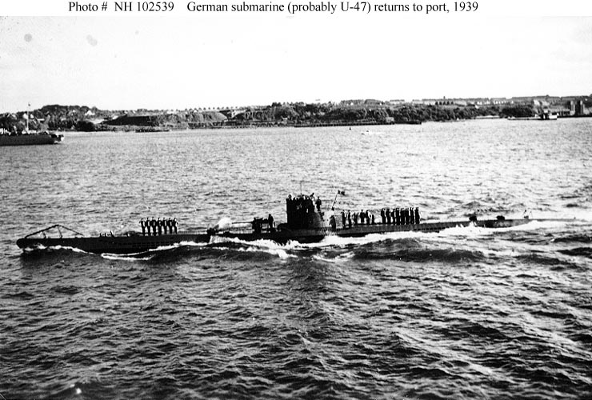
German Submarine Warfare
U-boat or Unterseeboot or submarine
1. Used to prevent munitions and food from reaching Britain’s ports
2. At first used to rise to top to allow crews to get off merchant ships
3. After Ships became armed, U-boats would fire without warning
4. Broke the stalemate in the sea
5. Battles proved that the U-boat was the only thing the German’s could use to break the stalemate in the sea

Slide 3
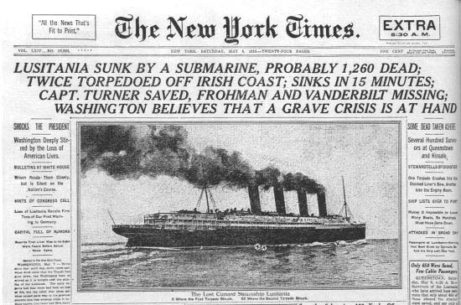
6. In America the British blockade was seen as fine but the German blockade was seen as uncivilized
May 7, 1915 a U-boat sunk the Lusitania a British passenger liner killing 1,200 people 128 were American
7. Wilson told German to stop firing on ships that had American people onboard, Germany said they would stop firing at ships without warning as long as the crew went along with German search and seizure.
8. March 24, 1916Germany attacked Sussex a French ship killing 80 people 2 of which were American signed the Sussex Pledge promising U-boats would warn before attacking
9. American Neutrality is greatly weakened; banks are encouraged to make huge loans to the Allies

Slide 4
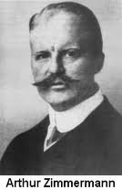
Moving Towards War
January 31, 1917 Germany called an end to the Sussex Pledge
The Zimmerman Note
British intercepted a telegram, Arthur Zimmerman Germany’s foreign secretary made an offer to Mexico saying if they declared war on the United States Germany would reward it with giving back Texas, New Mexico and Arizona
This was not taken very seriously because Mexico was engaged in a Civil War, but this did enrage the American public

Slide 5
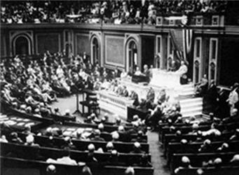
The War Resolution
Between March 16-18 Germany sank City of Memphis, Illinois and Vigilancia
March 20 the Presidents cabinet unanimously voted to go to war
The war resolution passed 82 to 6 in the Senate and 373 to 50 in the House.
April 6, 1917 The United States was in the War

Slide 6
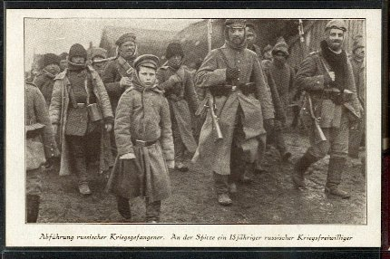
Russian Discontent World War I: “The Last Straw”
War revealed the ineptitude and arrogance of the country’s aristocratic elite
Corrupt military leadership and contempt for ordinary Russian people
Average peasant has very little invested in the War

Slide 7
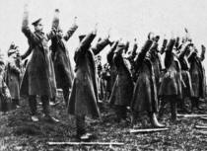
Poorly supplied troops
Result: Chaos and Disintegration of the Russian Army
Spreading Discontent

Slide 8
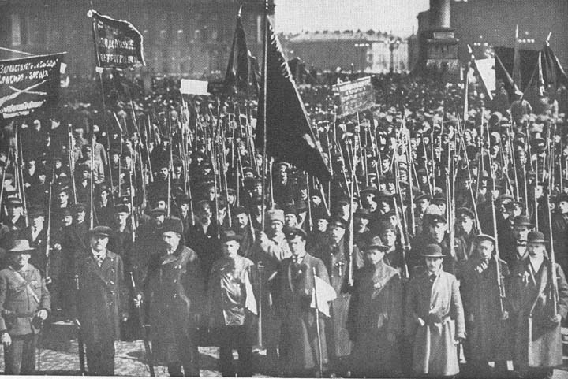
Russian Revolution
All private property of wealthy was abolished and divided among the peasantry
Largest industrial enterprises nationalized

Slide 9
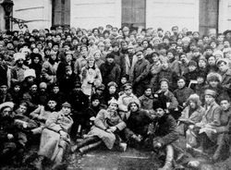
Russian Revolution (cont)
Bolshevik Party renamed Communist Party
The Treaty of Brest-Litovsk negotiated with the Germans – Thus eliminating a two front war for Germany
Rise of Communism in Russia

