Slide 1
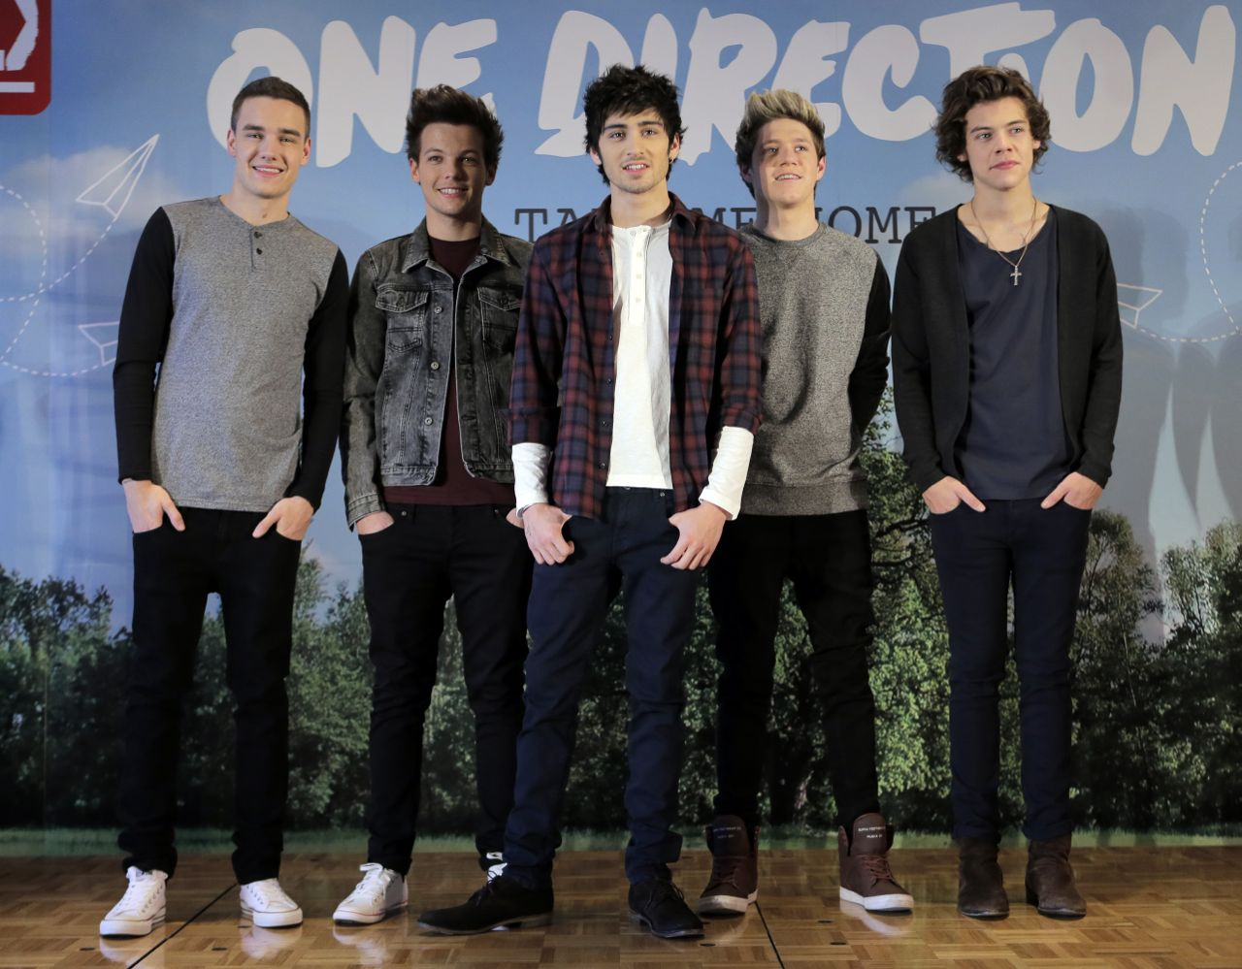
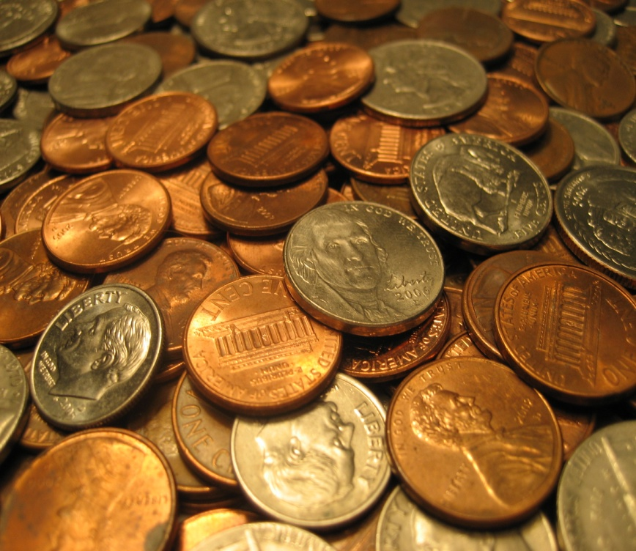
One D Money Team!!!!!
PowerPoint About Money
By Paige W.

Slide 2
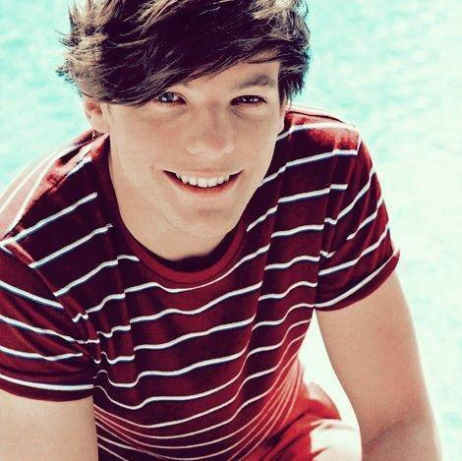
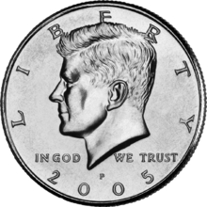
Hi we’re the One D money team. Wait a second, let’s introduce ourselves. I’m Louis a the half dollar.☺

Slide 3
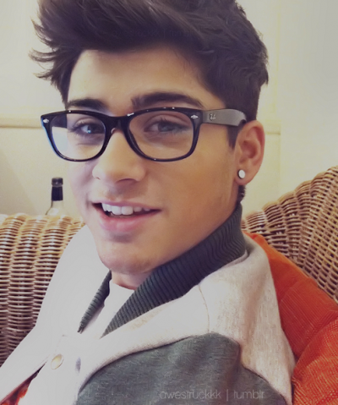
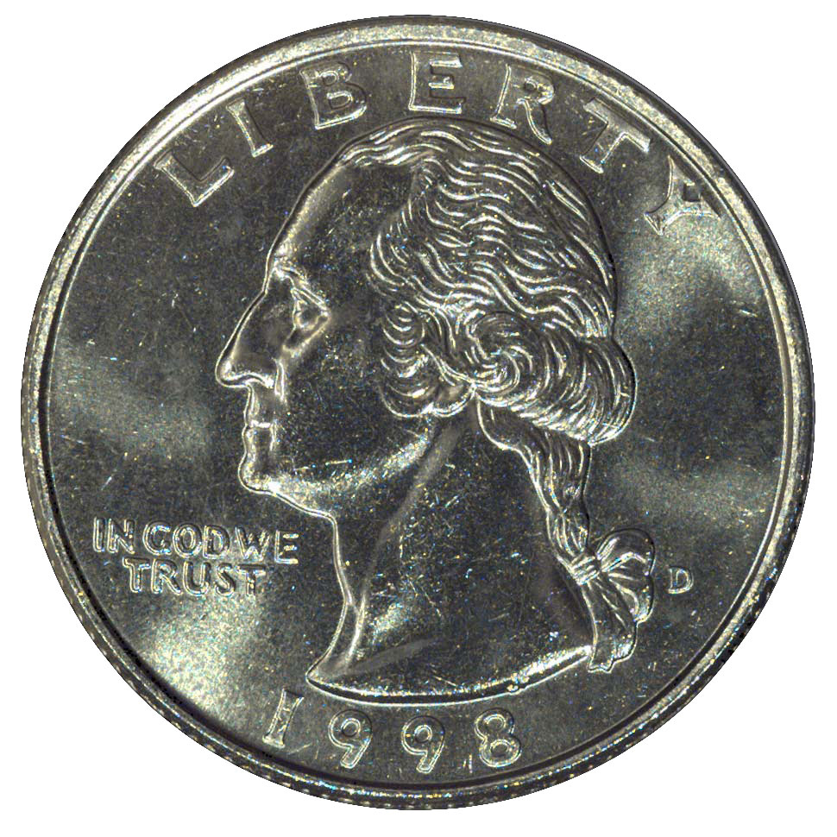
Hi, I’m Zayn the quarter.☺

Slide 4
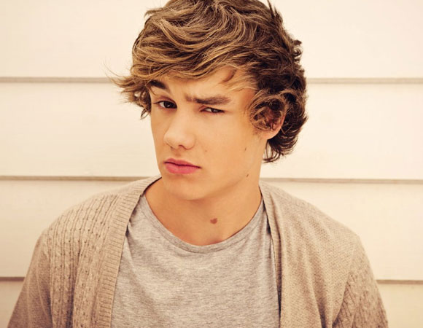
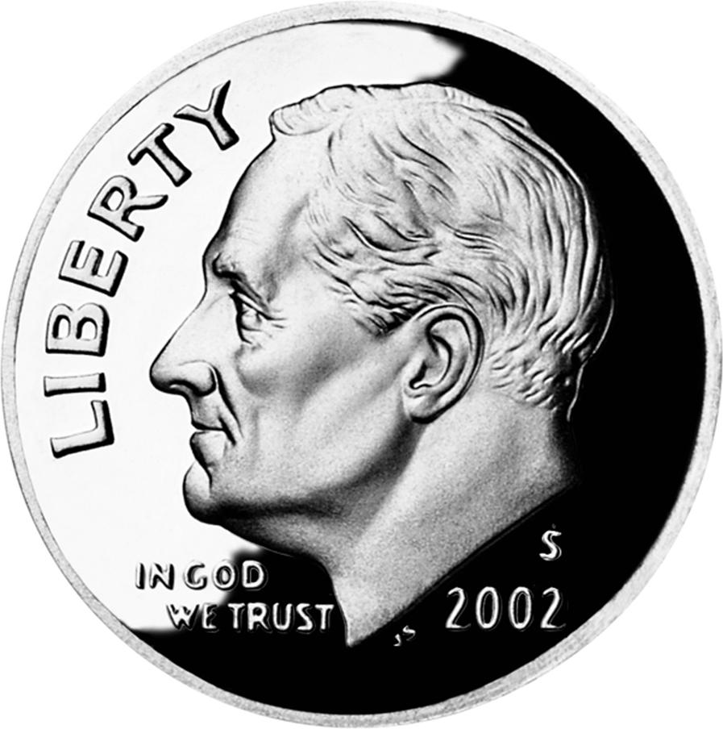
Hi, I’m Liam the dime.☺

Slide 5
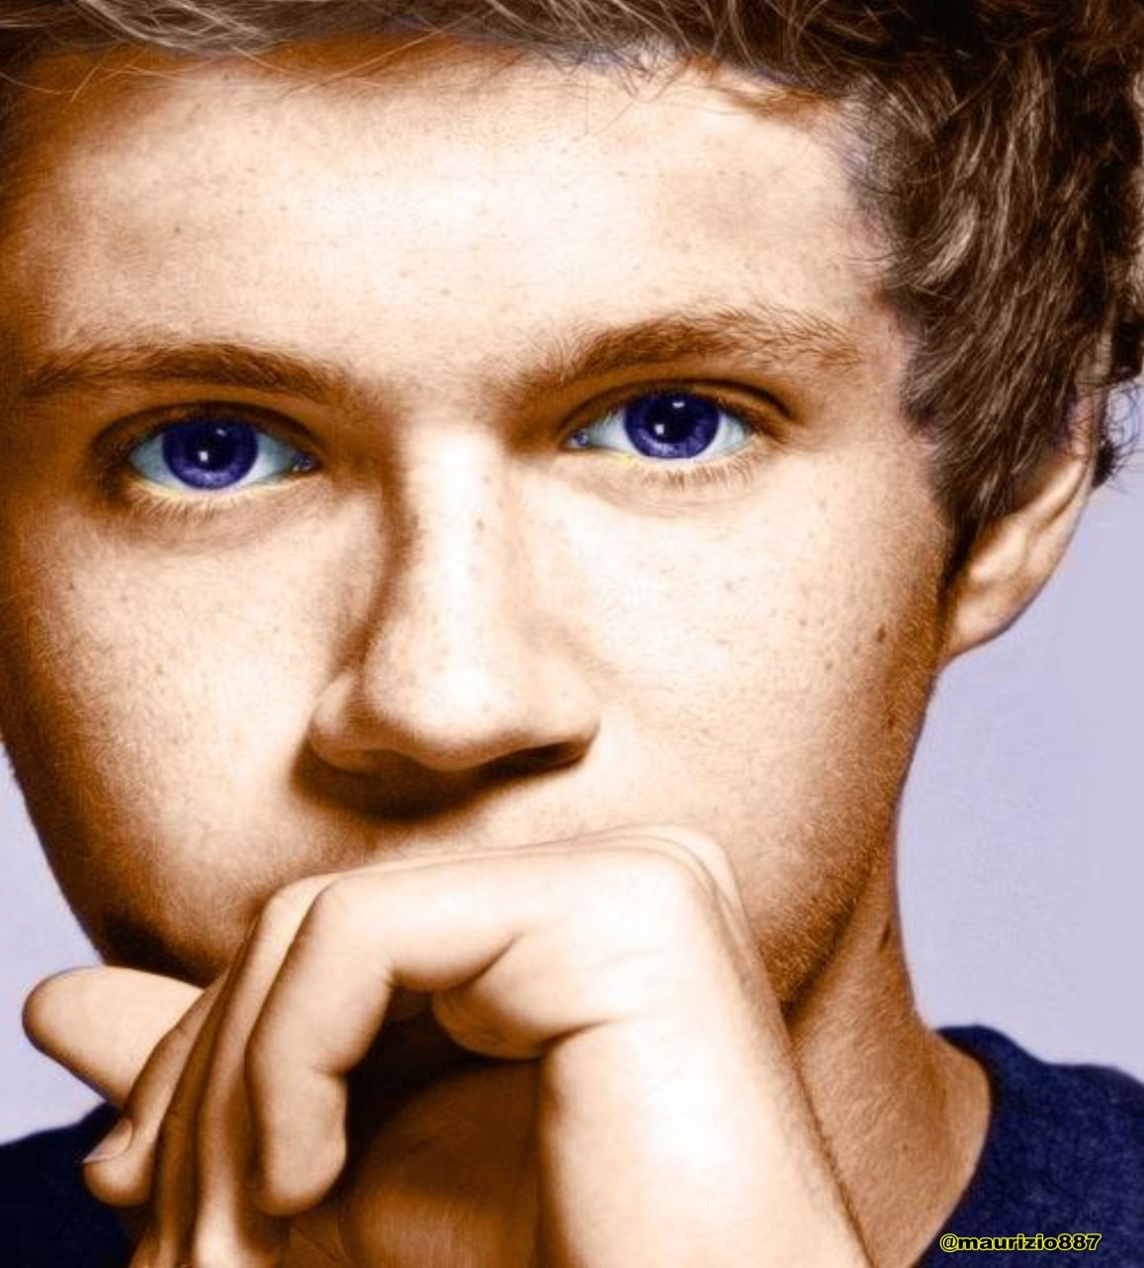
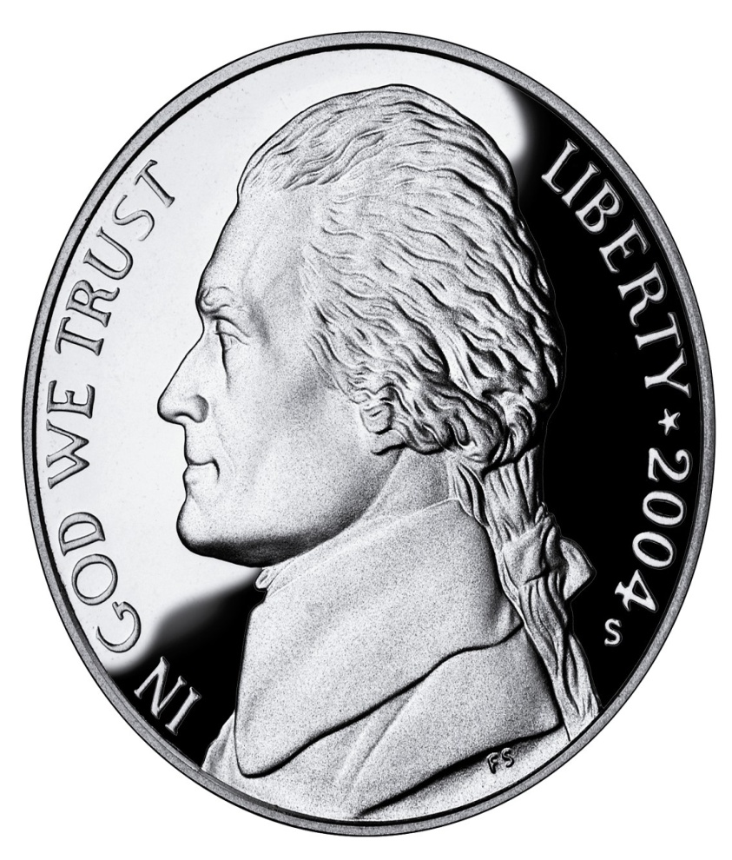
Hi, I’m Niall the nickel.☺

Slide 6
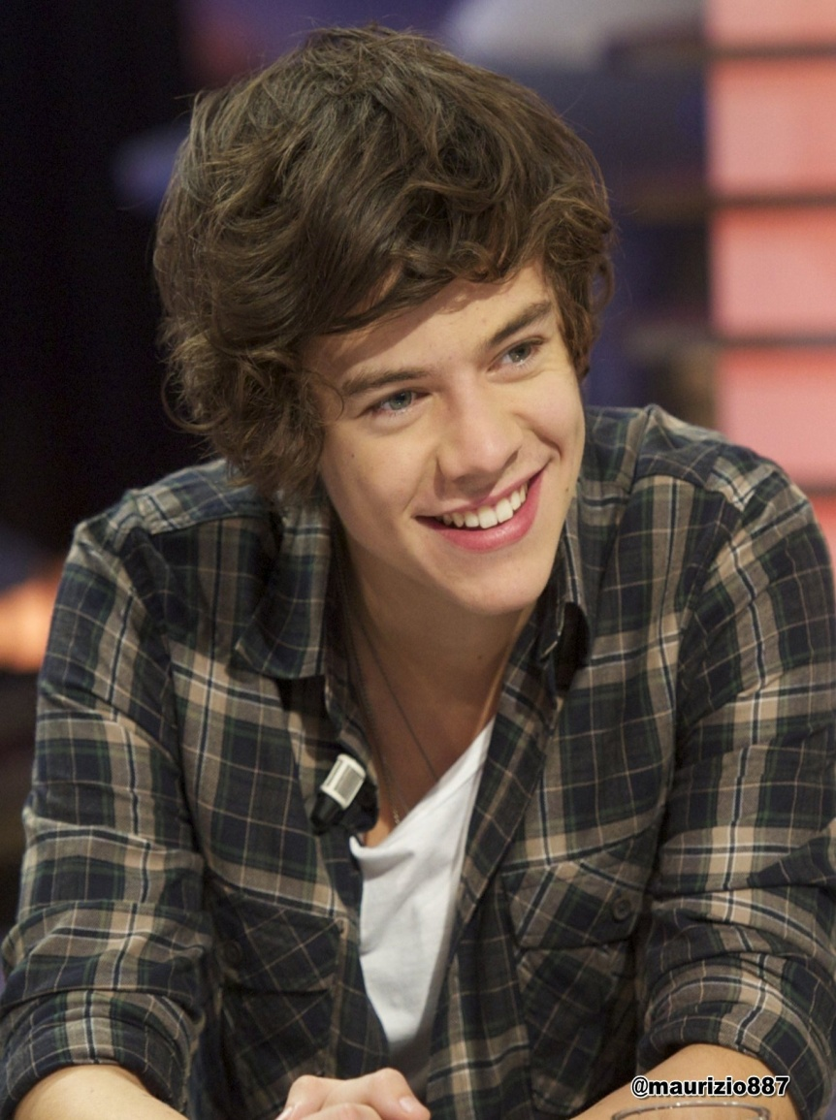
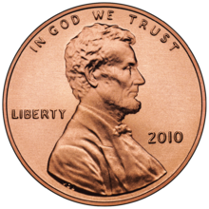
And last but certainly not least, Hi, I’m Harry the penny.☺

Slide 7
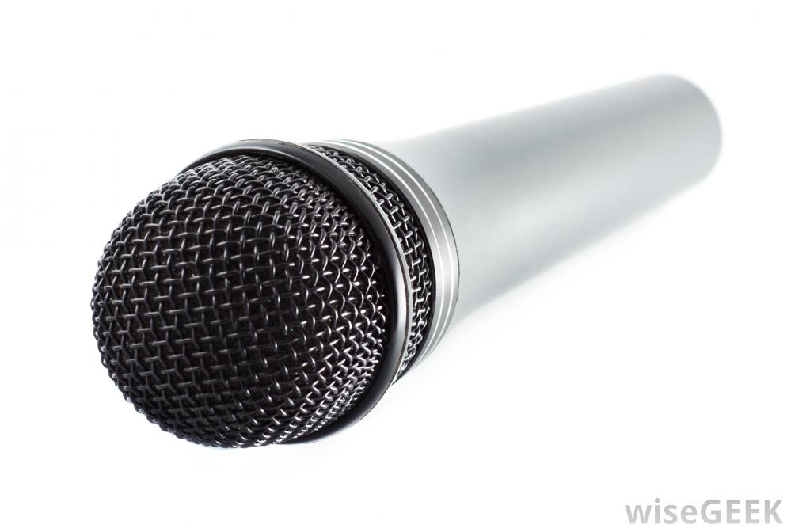
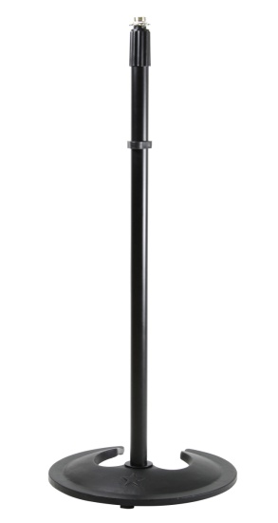
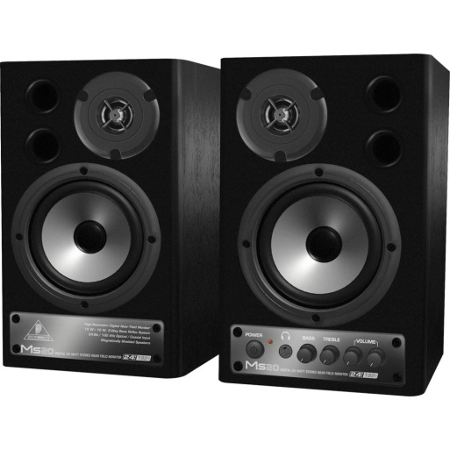
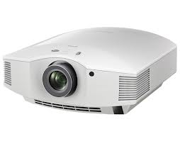
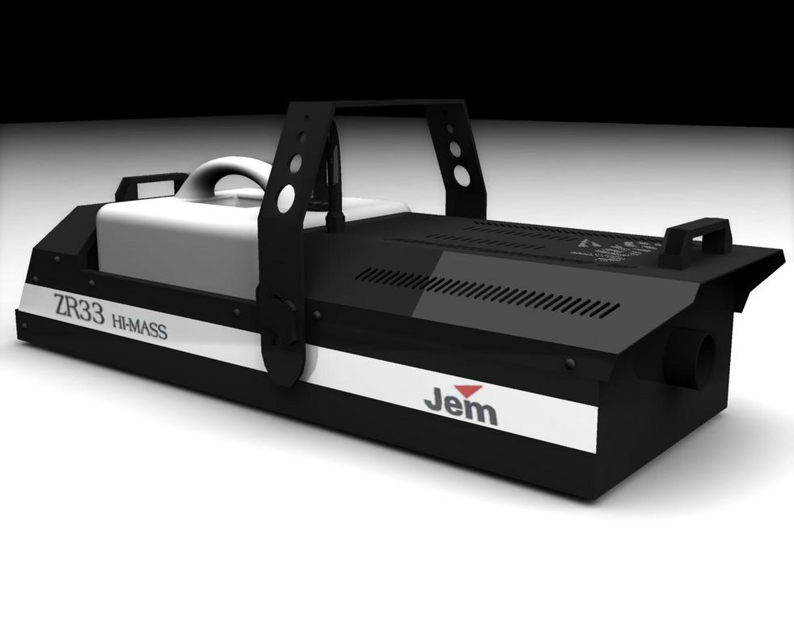
We’re having a concert and need equipment!

Slide 8
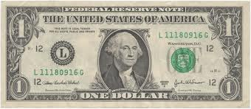
We’re at the store and need your help!!!! A smoke machine is $1.00 and Niall can’t figure out how many nickels there are in a $1.00.☹ Help him!

Slide 9
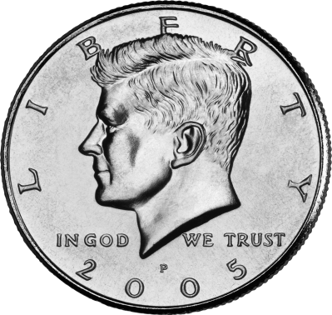
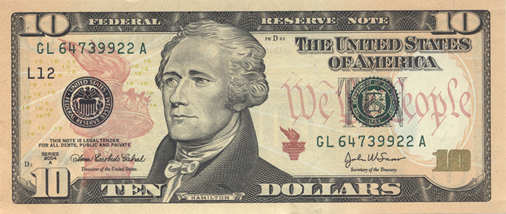
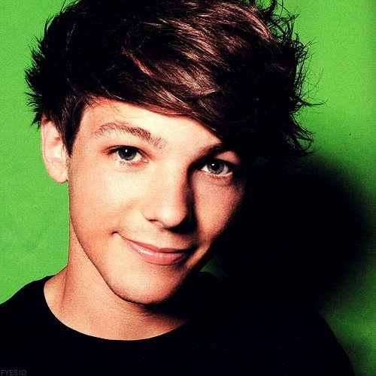
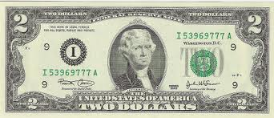
Wait one second for some more questions. $12.00=_____ half dollars

Slide 10
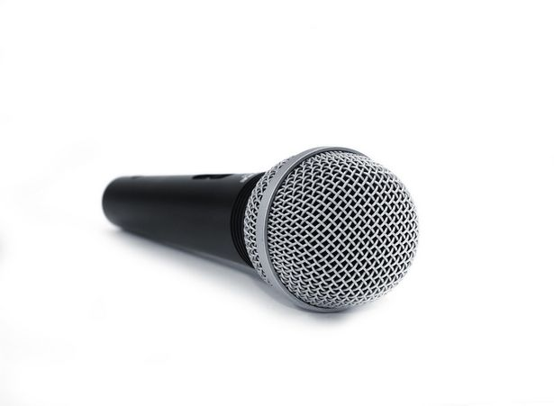
We also need a microphone its 10 dollars. So, how many pennies are in that amount? Are there any more ways to make $10.00?

Slide 11
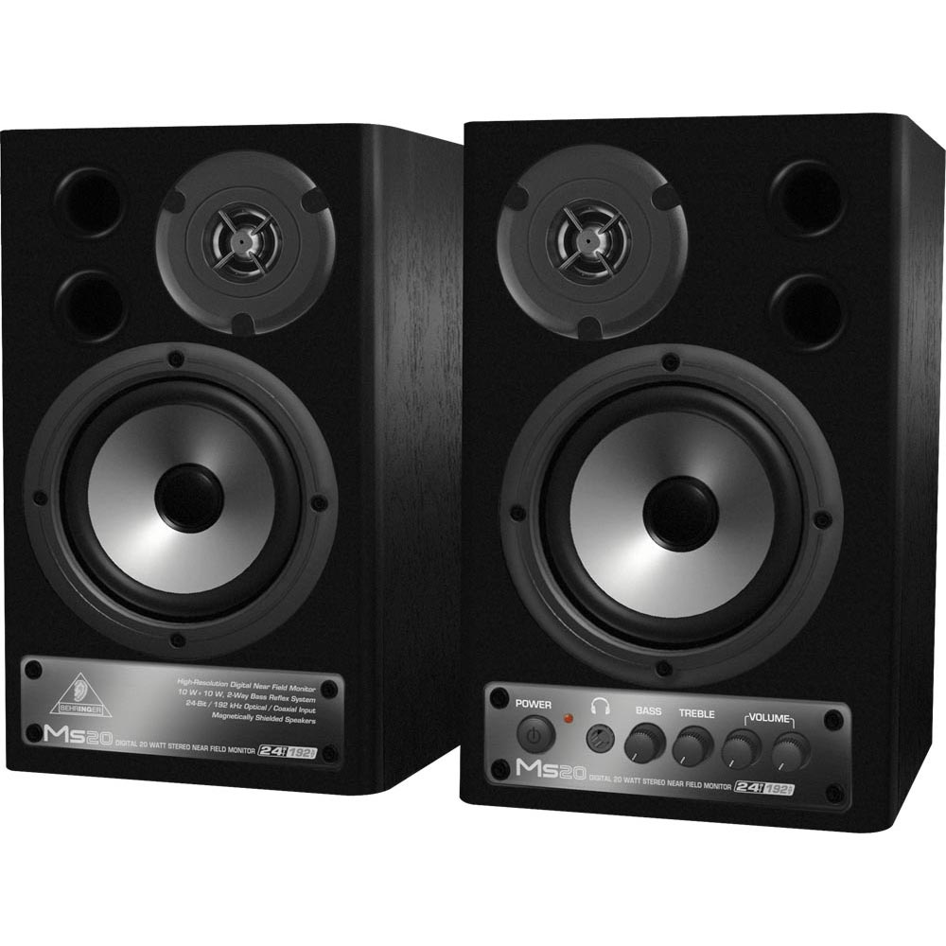
There is also the speakers that are ten dollars off! But we don’t know how much its worth! Please help its $29.00 and its thirteen dollars off. HELP!

Slide 12
Hi guys! One D Money Team here!!!!! Fans are waiting outside to meet us so Louis is going to stay with you. Right Louis? Absolutely. Hey guys! We bought that smoke machine so, thanks!!!!!!! Oh my well aren’t you woo..... Louis, Louis, were are you? Have you seen Louis??? Well anyway, the fans drop some money and we don’t know how much we have. We have three pennies, 6 nickels, 7 quarters, and 2 half dollars. Help! Louis is that you? Who else would it be? We’re coming just wait here. Louis!!!! Guys watch out there are some codes that you are going to have to solve!!! Here they are.

Slide 13
Solve these problems: 111-_____= 100 23_______43= 66 12-0+________= 36 32-0+13=_________ 42=_________+9

Slide 14
Answers: 1.) 11 2.) + 3.)24 4.)45 5.)33

Slide 15
12+6(6+5) associative or commutative 1+2=2+1 associative or commutative 4+3(7+8) =7+8(4+3) associative or commutative 4+3(8+9) associative or commutative 43+5=5+43 associative or commutative 4+2=2+4 associative or commutative

Slide 16
Answers: 1.)associative 2.) communitive 3.)associative 4.)associative 5.)communitive 6.) communitive

Slide 17
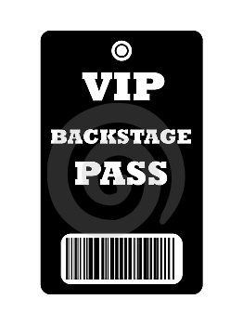
Thanks for helping out here is a backstage pass to our concert.

