Slide 1
The Financial Aid Process for 2022-2023
Presented by:
Faith Phillips
Director, Student Financial Services
Central Ohio Technical College & Ohio State Newark

Slide 2
The first F in "FAFSA" stands for "free!"
There are websites at which students can get help filing the FAFSA® form for a fee. These sites are not affiliated with or endorsed by the U.S. Department of Education (ED). Do not to pay these sites for assistance that is provided for free at ED's website.

Slide 3
What is FAFSA® and Financial Aid?
Free Application for Federal Student Aid- Standard free form that collects information about the student and the parent.
Financial Aid - Funds provided to students to help pay for educational expenses.

Slide 4
FAFSA
Information used to calculate the Expected Family Contribution (EFC)
Measure of 2020 taxable and untaxable income and current assets of both student and parent
Other factors = family size, number in college and other demographic info such as marital status and the age of the older parent.
Colleges use the EFC to determine financial aid eligibility
For the 2022-2023 academic year, the FAFSA may be completed beginning
October 1, 2021
NOTE: Re-apply/submit the FAFSA every year
The earlier you file, the earlier you may receive your aid offer and the more aid you may be offered
Most colleges set FAFSA filing priority dates
Admissions process vs. Financial Aid process

Slide 5
Sources of Financial Aid
Federal Government
Employers
States
Private Sources
College and Universities

Slide 6
FAFSA on the Web (FOTW)
Built-in edits to prevent costly errors
Skip-logic allows student and/or parent to skip unnecessary questions
Option to use Internal Revenue Service (IRS) Data Retrieval Tool to import tax data
More timely submission process
Detailed instructions
Simplified process in future years

Slide 7
Federal Student Aid ID https://studentaid.gov/fsa-id/create-account/launch
The FSA ID is the electronic signature for the FAFSA
Used by students and parents throughout financial aid process, including subsequent school years
FAFSA Corrections
FAFSA Renewal
Student Loan Promissory Note Signatures
Only the owner should create an FSA ID
Each student must have their own FSA ID
One parent must have their own FSA ID

Slide 8
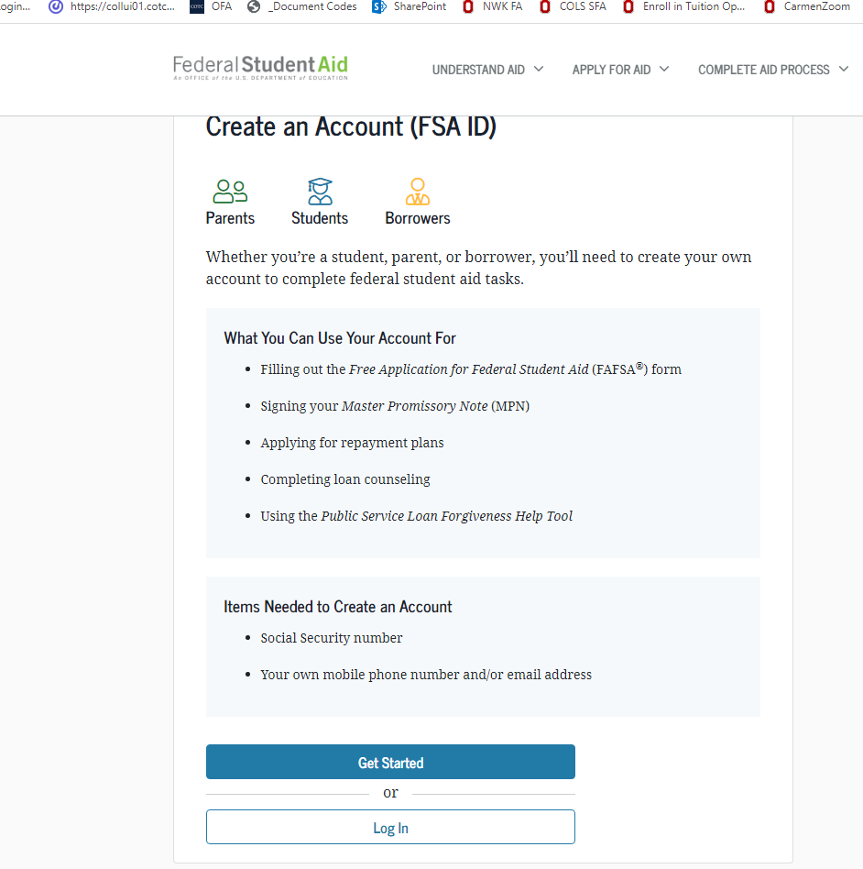
FSA ID
Name
Social Security Number
Date of Birth
Email address
Not High School Email
May only use an email one time
Mobile Phone Number
May only use a mobile number one time

Slide 9
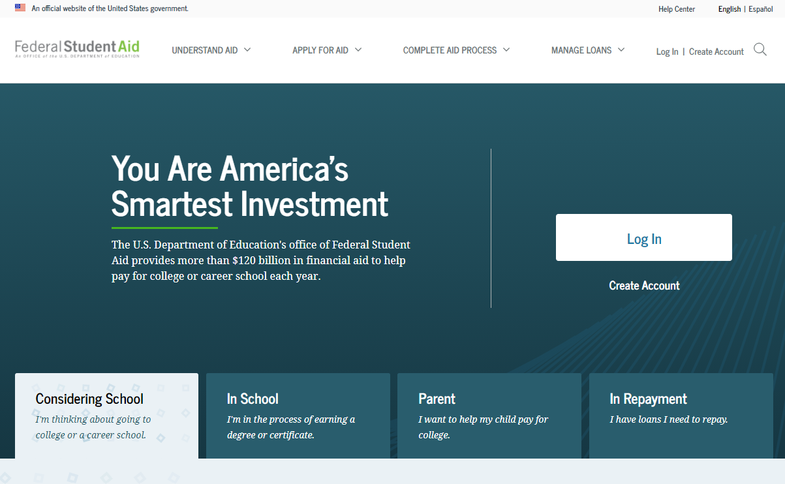
StudentAid.gov Home
Notes:
StudentAid.gov home view

Slide 10
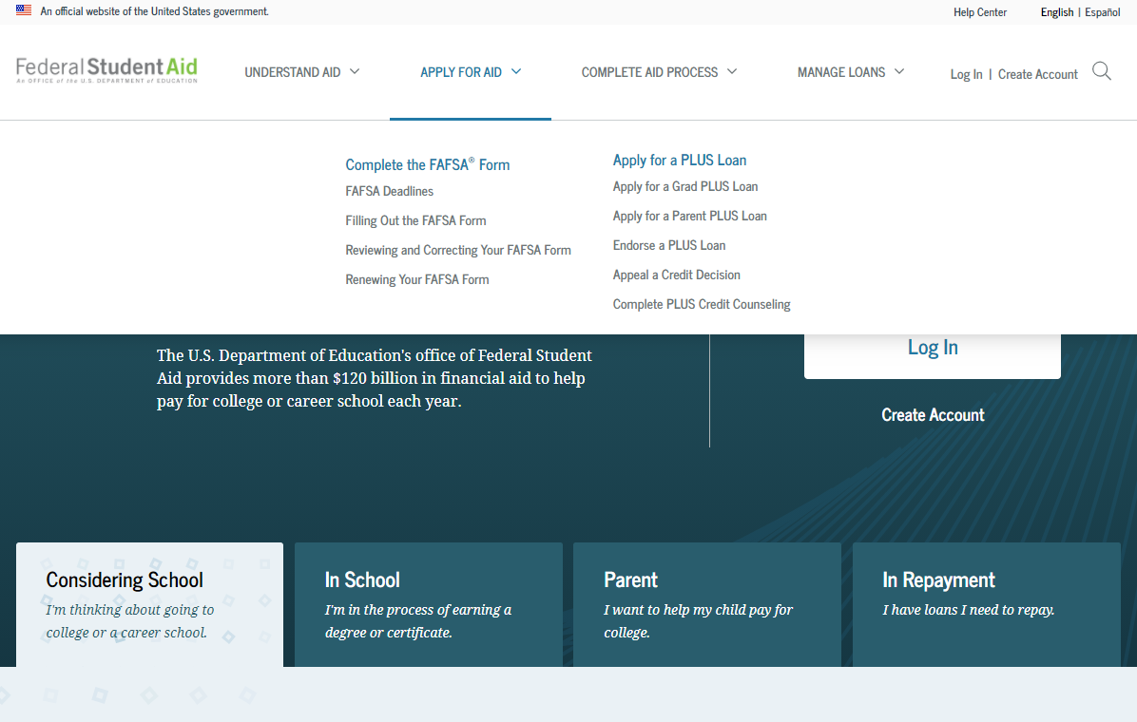
Apply for Aid
Notes:
Apply for Aid header view
If the applicant is navigating to the FAFSA form from the StudentAid.gov home page, he or she can select “Apply for Aid” from the page header, then select “Complete the FAFSA® Form.”

Slide 11
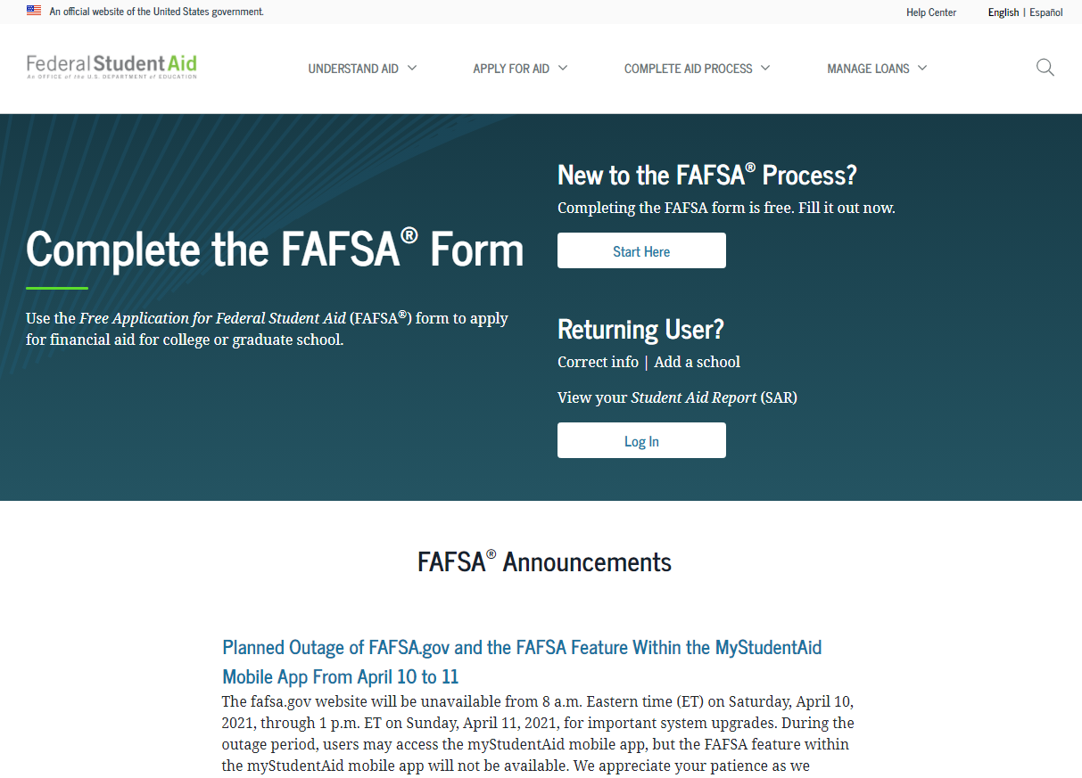
FAFSA on the Web (FOTW)
Begin with “Start Here”
Once student record is established you will Log In each time

Slide 12
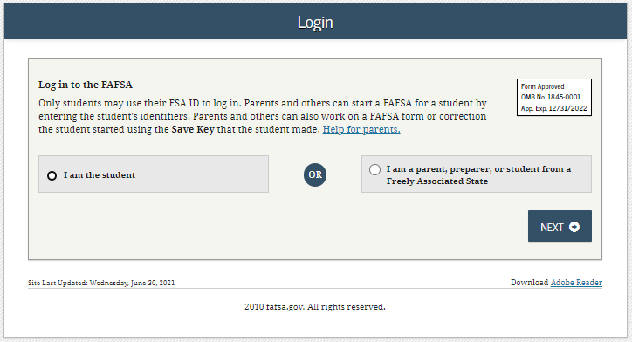
FAFSA on the Web Login

Slide 13
FAFSA/Award Year
Until October 1 the only FAFSA year available is 2021-2022
Seniors in High School now will file the 2022-2023 FAFSA, available on October 1, 2021
Two years will be displayed on October 1, be sure to select:
2022-2023

Slide 14
Filing the Wrong FAFSA year
Failing to use student’s legal name
Missing financial aid deadlines
Transposing digits or inserting extra digits
Using incorrect Social Security Numbers/Date of Birth
Submitting wrong parent’s financial information/not including step-parent
What to include for investment/net worth

Slide 15
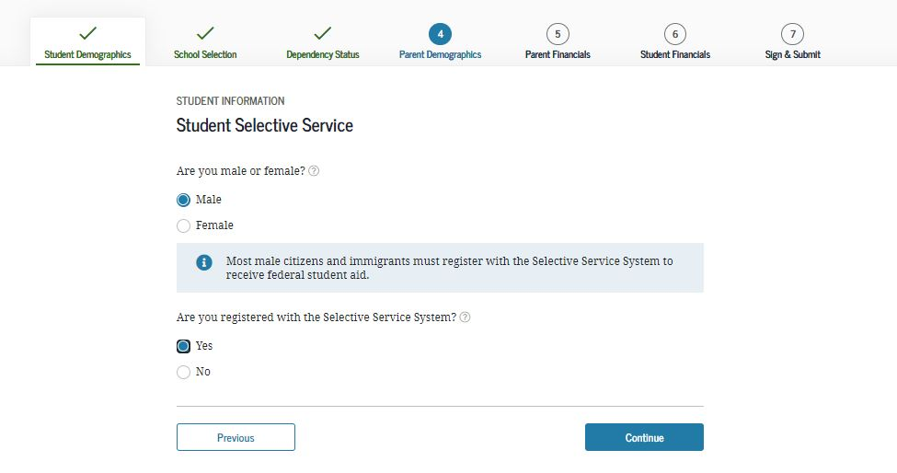
Selective Service
Reminder to register with SS
The answer does not impact aid eligibility.

Slide 16
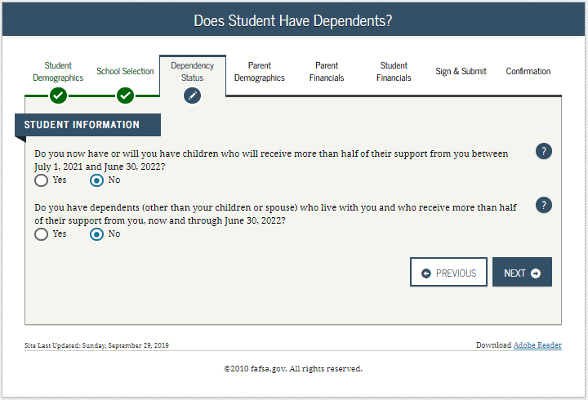
Dependency Status Determination
Answer “NO” to all questions, student is dependent and must provide parent information
Answer “YES” to any one question, student is independent and does not provide parent information

Slide 17
Dependency Status Determination

Slide 18
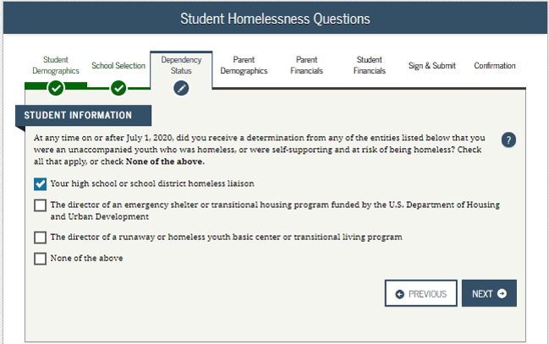
Homeless/at Risk For Homelessness
If applicant falls in this category, they will skip parental information and be considered Independent.

Slide 19
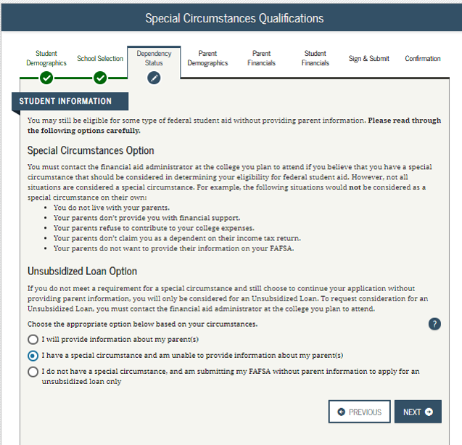
Student is determined to be Dependent but has Special Circumstances

Slide 20
Dependency Special Circumstances
Examples of Special Circumstances
Not a Special Circumstance
Both parents are incarcerated
Student left home due to an abusive environment
Student is estranged from both parents
Student does not know where parents are and are unable to contact them
Student does not live with parents
Parents do not provide student financial support
Parents refuse to contribute to college expenses
Parents do not claim student as a dependent on tax return
Parent refuses to complete the FAFSA

Slide 21
Dependency Special Circumstances
A dependent student with special circumstances may submit the FAFSA without parental information.
The student should follow-up with the financial aid office at the college(s) they have applied to explain and document their circumstances.
If the college finds the circumstance and documentation acceptable, they will update the FAFSA to override the student status to Independent.

Slide 22
Student is determined to be Dependent

Slide 23
WHO is the Parent for the FAFSA?
Biological or Adoptive Parent(s)
If not married BUT living together report BOTH parents
If parents are divorced:
Provide information for the parent you lived with most during the last 12 months
If you did not live with 1 parent more than the other, the parent who provided the most financial support during the last 12 months or most recent year you received support
Include Step-parent information
Regardless of any ‘agreements’

Slide 24
Parent Information
Information for Parent #1
Information for “Other Parent”

Slide 25
Household Information

Slide 26
IRS Data Retrieval Tool (DRT)
Allows for certain tax return information to be transferred from the IRS database
Participation is voluntary and student/parent chooses whether to transfer data to FOTW
IRS will authenticate taxpayer’s identity
If tax record is found, IRS transfers information to populate the FAFSA
Reduces documents requested by financial aid office
Certain tax filers cannot use the DRT

Slide 27
Eligible for IRS DRT

Slide 28
Net worth of investments (As of ‘today’)
Cash, Savings, and Checking
Investments/Business/Farm Value
Current/market value minus debt = Net Worth
Real estate (not home you live in), trust funds, money market and mutual funds, CD’s, stocks, bonds, commodities
Education benefits/savings accounts (Coverdell, 529, refund value of prepaid tuition plans)
Asset of the parent not student
Must include value of ALL accounts owned by parent

Slide 29
Assets NOT included on the FAFSA
Value of your primary residence
Value of Life Insurance
Traditional Retirement Plans
Cash, Savings, Checking already reported
Business or farm with 100 or fewer full-time or full-time equivalent employees
Family Farm you live on and operate

Slide 30
School Selection

Slide 31
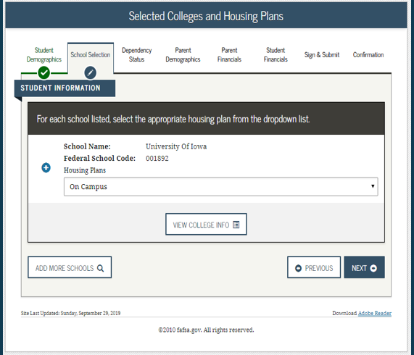
Housing Plans

Slide 32
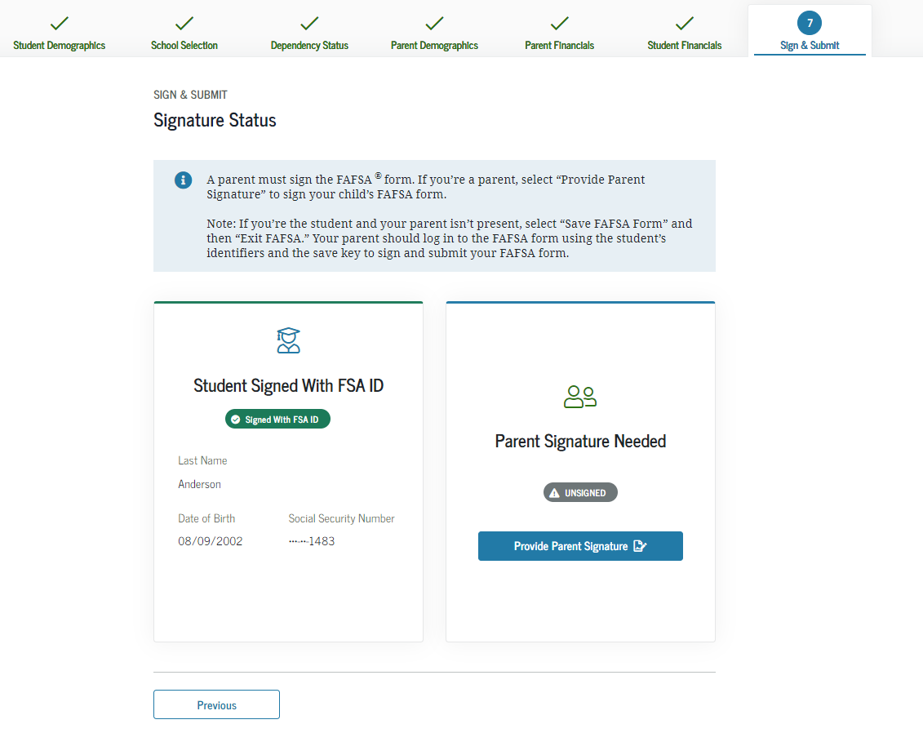
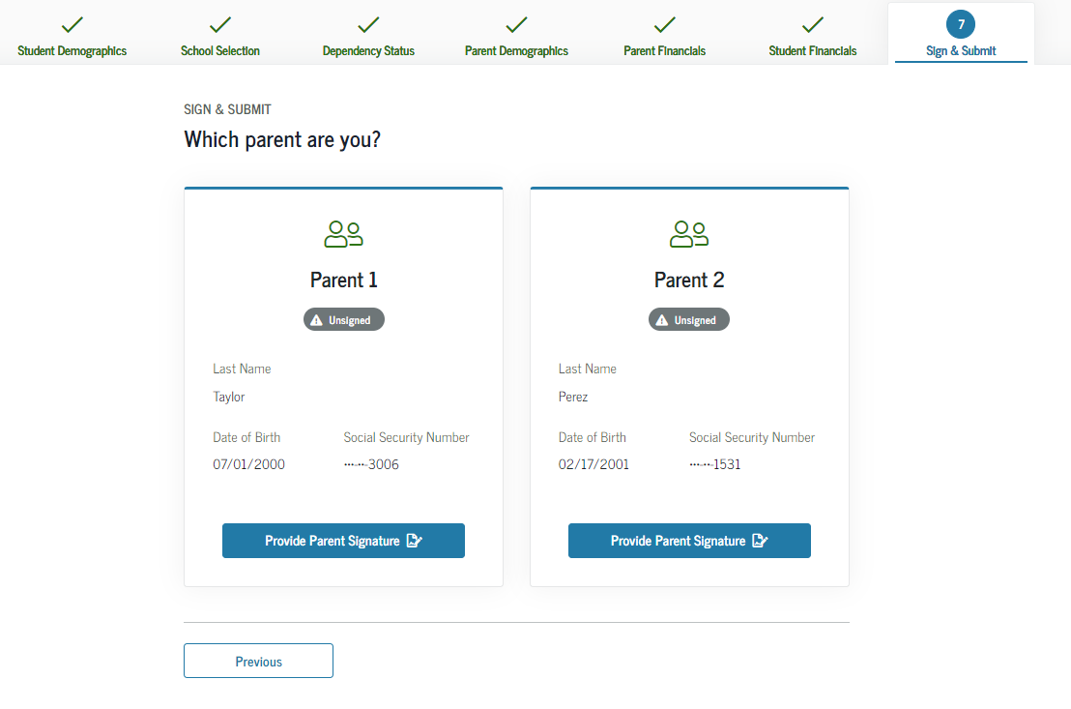
Sign
Other options to sign and submit
Print signature page OR
Submit without signatures
“View or Print your FAFSA information

Slide 33
Submit

Slide 34
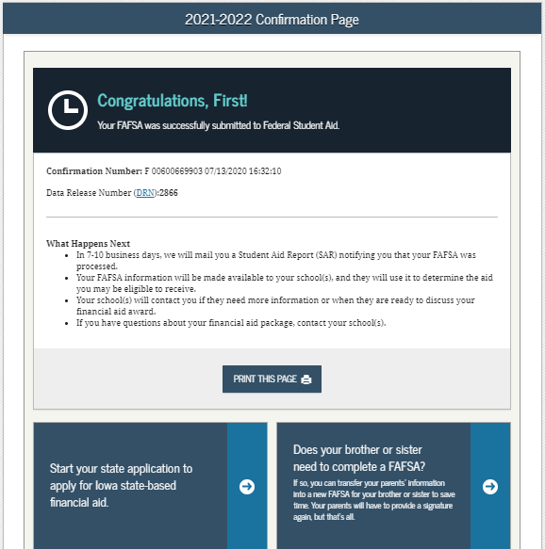
Confirmation Page
Includes -
Confirmation Number
EFC estimate
Pell Grant and Direct Loan estimates
Option for parents to transfer info to an application for a sibling

Slide 35
FAFSA Processing Results
CPS
College
Student

Slide 36
Making Corrections
Corrections to FAFSA data may be made on FAFSA on the Web
Add more schools
Correct any mistakes (school may ask you to document)
Do not UPDATE data such as assets/savings

Slide 37
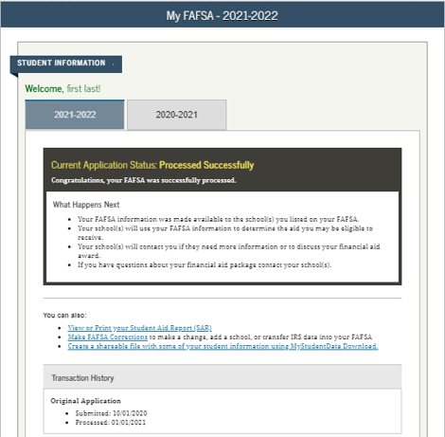
Processing Results
Student Aid Report
Make a Correction

Slide 38
Special Circumstances
Loss of Child Support
Unusual uncovered medical/dental expenses
Extraordinary dependent care
Student cannot obtain parental information
Parent or spouse death
Loss of employment
Divorce

Slide 39
Special Circumstances
Conditions exist that cannot be documented with the FAFSA
Send written explanation and documentation to your college’s financial aid office
College will review and request additional information if necessary
Decisions are final and cannot be appealed to U.S. Department of Education

Slide 40
Financial Aid Office reviews FAFSA
May request additional information
Verification of Income
Household size/Number in college
Determines Financial Aid Offer
Usually emailed
Amount of Aid awarded from each program
How and When aid is disbursed
Terms and Conditions of student’s award

Slide 41
College Communications with the student
Most colleges/universities use a school portal
an online resource that students can access to register for classes, view financial aid and billing.
Most colleges/universities use a school assigned email account
students are required to activate and check regularly.
Schools will begin to communicate with the student primarily through this email account.

Slide 42
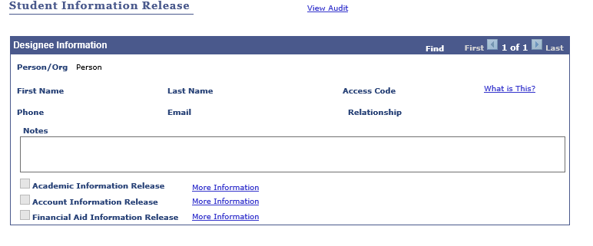
College Communications with the student
Once a student enrolls in college, their college record (academics and finances) become protected under FERPA and students would need to give parent/guardian permission to access this information if they choose. EXAMPLE Below:

Slide 43
Faith Phillips
Director of Student Financial Services
The Ohio State University at Newark
Central Ohio Technical College
740-366-9492
phillips.495@osu.edu

